Slide 1
Intein Misrepresentation: Analyzing NCBI Data for Biotechnological Integrity
Dylan Skalman
DSA 688

Slide 2

Background

Slide 3
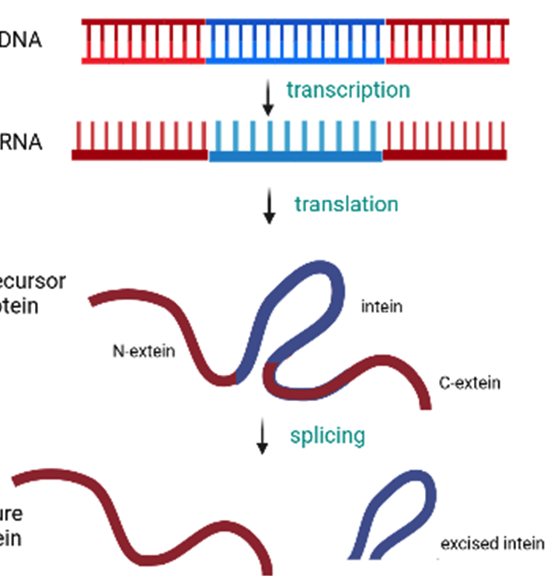
What are Inteins?
An intein is a kind of protein that carry's out a process known as protein splicing, a biochemical reaction comprised of both the cleavage and formation of peptide bonds resulting in the formation of a functional protein. (1)
They are auto-processing domains found in organisms from all domains of life. Their roles in nature are still being explored.
Inteins hold significant potential in biotechnical applications such as protein engineering, drug targets and therapeutic tools.

Slide 4
The Problem With Intein Data
As inteins are studied, data such as their sequences are stored on public government websites like NCBI.
From the NCBI Mission page “The NCBI has been charged with creating automated systems for storing and analyzing knowledge about molecular biology, biochemistry, and genetics”.
A significant amount of intein related protein records that were once accurately displayed, have been removed or modified on NCBI causing a misrepresentation in biological data.

Slide 5
Project Motives
The goal of this project is to obtain a better understanding of missing and modified intein containing protein records and learn why they have been altered on NCBI. The findings of these records will serve as evidence for these inaccurate records to be corrected.
The impact of this inaccurate data can compromise research accuracy and distort scientific conclusions in the emerging field of intein research and across disciplines.

Slide 6

Materials and Methods Section

Slide 7
Understanding The Modified Data
To assess the quantity of affected sequences, we utilized a dataset that had intein containing protein sequence numbers on NCBI provided by Dr. Novikova from one of her previous studies.
The 506 unique sequences were once accurately displayed on NCBI were manually searched on the website to tell if they were present and if there was any mention of “intein” in the sequence description.

Slide 8
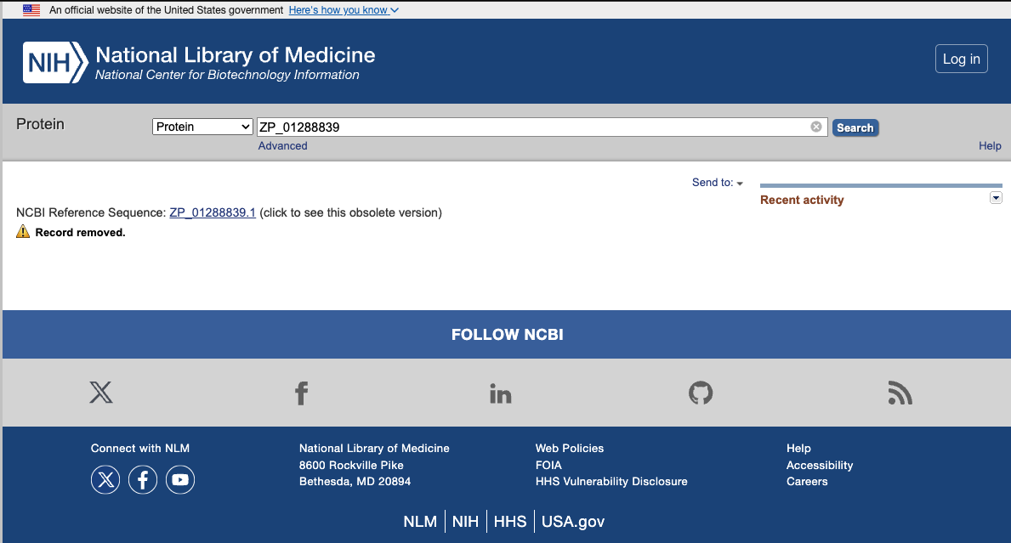

Slide 9
Collecting Additional Intein Data
The NCBI protein database was queried to fetch protein records for 3 different taxonomies - eukaryota, pseudomonadata and actinomycetota.
The search queries were filtered for sequence lengths between 550 and 5000 nucleotides for eukaryota and pseudomonadata and between 1000 – 5000 for actinmycetota due to the abundance of records, making for an intensive download.
The search queries targeted replicative DNA helicase proteins as they are known to commonly contain inteins.

Slide 10

Tools Implemented
Data mined was downloaded as a feature table text file for each taxonomy.
Python was used to parse and isolate sequences and their data from these text files, and each data frame was cleaned and joined to make one comprehensive dataset.
Charts and calculations were performed using the matplotlib.pyplot library.

Slide 11

Results Section

Slide 12
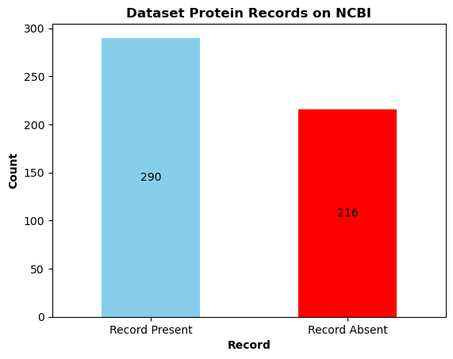
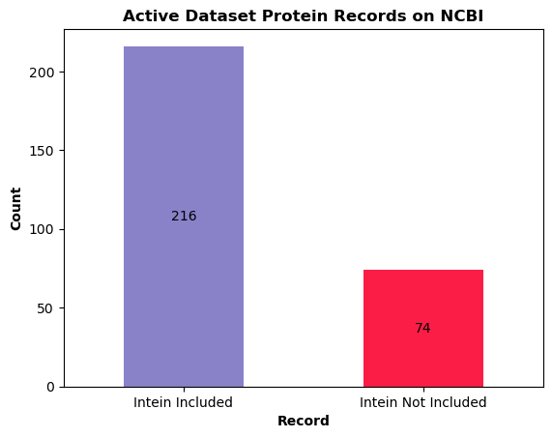
NCBI Intein Sequences Acquired From Dr. Novikova’s Dataset
1A. Bar chart showing the count of present and absent intein containing protein records obtained from intein dataset on NCBI.
1B. Bar chart showing the count of accurate intein containing protein records obtained from the intein dataset when searched on NCBI. For an intein containing protein records to be accurate, the word “intein” must be included in the protein description or sequence.
From Figure 1A, out of 506 intein containing protein records, 57.3% (290 records) were present on NCBI’s database and 42.7% (216 records) were missing. Of the 290 present records, 216 were accurate, including an intein region in the protein sequence while 74 were inaccurate, lacking the mention of an intein in the sequence of the protein.

Slide 13
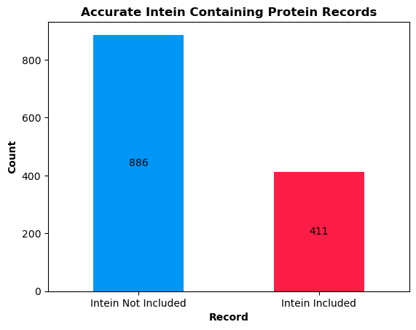
Records Mined From NCBI
A total of 3100 protein records were mined from NCBI and were filtered for those that had a “PRK07773” region in their description as this is an intein annotating profile.
83.3% (986 of 1184) of actinmycetota records, 7.1% (43 or 605) of eukaryota records and 20.4% (268 of 1311) pseudomonadata records contained the PRK07773 annotation.
41.8% (1297 of 3100 fetched records) contained the PRK07773 profile. Of these records 411 mentioned an intein in their description while 886 did not.
2A. Bar chart showing the count of accurate intein containing protein records obtained from actinomycetota, eukarryota and pseudomonadata taxonomies with filters applied on NCBI. For an intein related protein record to be accurate, the word “intein” must be included in the protein sequence.

Slide 14
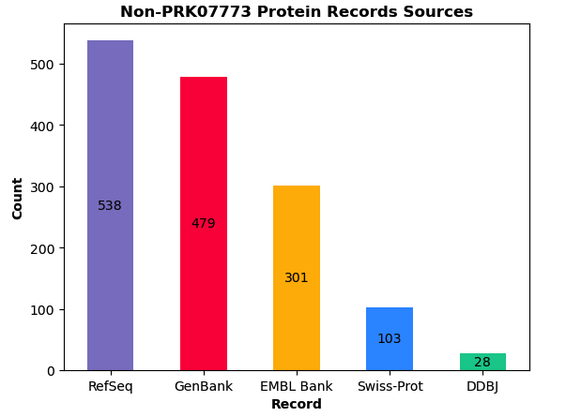
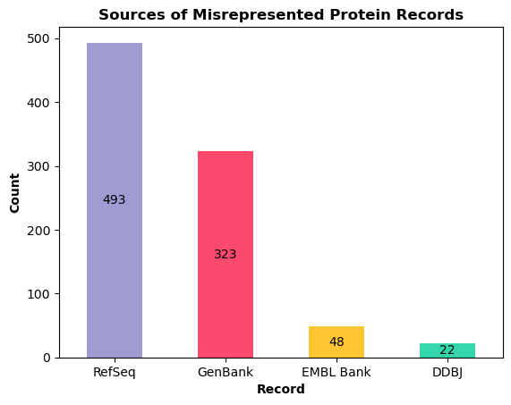
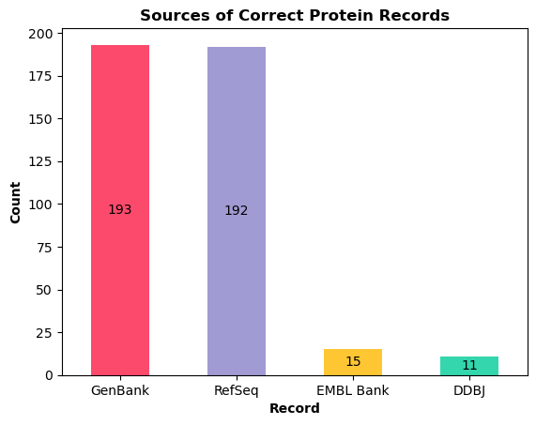
Sources of NCBI Protein Records
3A. Bar chart showing the count of non PRK07773 protein records sources obtained from actinomycetota, eukaryota and pseudomonadata taxonomies mined from NCBI.
2C. Bar chart showing the count of sources for misrepresented intein containing protein records obtained from actinomycetota, eukaryota and pseudomonadata taxonomies mined from NCBI.
2B. Bar chart showing the count of sources for correctly represented intein containing protein records obtained from actinomycetota, eukaryota and pseudomonadata taxonomies mined from NCBI.
Records on NCBI come from a variety of different contributors. The majority of sources for accurate, inaccurate and PRK07773 lacking protein records were GenBank and RefSeq.

Slide 15

Discussion

Slide 16
The Importance of This Study
Analysis of Dr. Novikova’s dataset that had 506 unique protein sequences that were once accurately displayed on NCBI, only 57.3% were present on NCBI. Of these 290 active records 216 were accurate as they mentioned an intein.
Through mining 3100 protein records on NCBI, it was found that a significant number of these records were inaccurate as only 411 mentioned an intein in their description.
This misrepresented intein data has the potential to lead researchers to obtain inaccurate results and draw misguided conclusions about the distribution and function of inteins in various organisms, posing a threat to ongoing research.

Slide 17
Future Relevance
This evidence from this research and data will be submitted to NCBI so that the inaccurate and missing biological data can be corrected and validated for scientific use.
To explore the scope of misinterpreted biological data on NCBI, more intein containing protein sequences from different taxonomies should be mined and inspected as this study only inspected 3.
It is important that scientists and researchers involved in the emerging field of the study of inteins are well equipped with accurate data from NCBI to not be misguided by misrepresented data in their findings.

Slide 18
Professional Experience
Developed and implemented a research plan for inspecting, collecting and analyzing intein data from NCBI.
Conducted NCBI database queries and used python to manipulate and analyze data
Collaborated with Dr. Novikova, a professor and researcher at Buffalo State University to discuss progress and findings

Slide 19

Thank you

Slide 20
References
Shah NH, Muir TW. Inteins: Nature's Gift to Protein Chemists. Chem Sci. 2014;5(1):446-461. doi: 10.1039/C3SC52951G. PMID: 24634716; PMCID: PMC3949740.
“Our Mission - NCBI.” National Center for Biotechnology Information, U.S. National Library of Medicine, www.ncbi.nlm.nih.gov/home/about/mission/. Accessed 28 Apr. 2024.
Novikova O, Jayachandran P, Kelley DS, Morton Z, Merwin S, Topilina NI, Belfort M. Intein Clustering Suggests Functional Importance in Different Domains of Life. Mol Biol Evol. 2016 Mar;33(3):783-99. doi: 10.1093/molbev/msv271. Epub 2015 Nov 25. PMID: 26609079; PMCID: PMC4760082.

